Slide 1
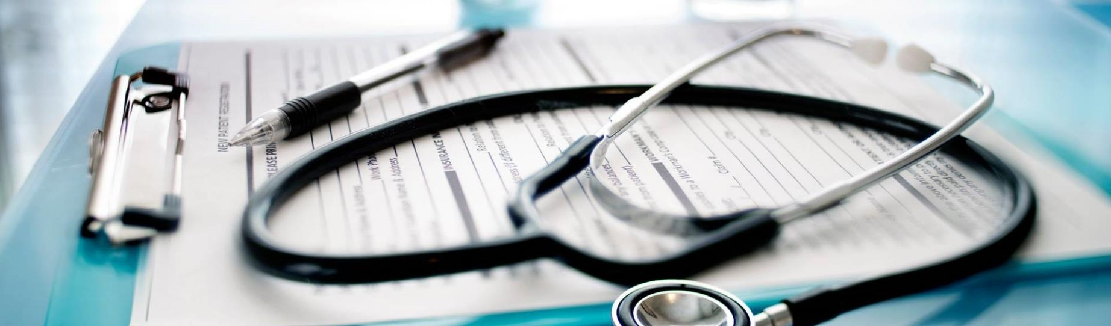
Effective Machine Learning Techniques To Detect Fatty Liver Disease
Project Guide:
Mr. N. V. Naik
Sr. Assistant Professor
Presented By:
D. Nasreen
S. Chowdeswar Reddy
P. Lasya Sri

Slide 2
Contents:
Abstract
Introduction
Motivation
Literature Survey
Existing System
Proposed System
Architecture
Result Analysis
Graphical Representation
Conclusion

Slide 3
Abstract
Heart disease, lung disease, respiratory disease, etc. are currently the top killers. The majority of liver problems are difficult to detect early on. One of these is fatty liver disease, a common disorder brought on by a collection of too much liver fat. Hepatic steatosis is an additional name for it. Drinking heavily makes you more prone to acquire it. Alcoholism causes the cells of the liver to accumulate fat. The liver's ability to function is hampered by this. It could result in cancer of the liver and liver damage. Even if a person does not regularly consume alcohol, they can nonetheless get fatty liver disease. Blood tests, ultrasounds, and computerized tomography scans are the three main types of diagnostic tests. A more precise and dependable, for the early identification of fatty liver disease, automated software is needed. To anticipate the disease, particular machine learning models are created for this purpose. To identify the fatty liver disease with specificity, accuracy, and dependability, methods of Naive Bayes (NB), Random Forest (RF), and eXtreme Gradient Boosting with ANN are proposed in this study. A total of 70000 cases are included in the collection. This classification system is assessed for precision using a confusion matrix.

Slide 4
Introduction
Nowadays the main leading causes of death are heart disease, respiratory disease, lung disease, etc…Most liver disorders can’t be identified at an early stage. One of them is a fatty liver disease which is a common condition caused by having too much fat build up in your liver. It is also known as hepatic steatosis. Heavy drinking obliges more likely to get it. It can get even if they don’t drink a lot of alcohol. A healthy liver contains a small amount of fat. It becomes a problem when fat reaches 5% to 10% of your liver’s weight.
It progresses through three stages:
Your liver becomes inflamed (swollen), which damages its tissue. This stage is called steatohepatitis.
Scar tissue forms where your liver is damaged. This process is called fibrosis.
Extensive scar tissue replaces healthy tissue. At this point, you have cirrhosis of the liver.

Slide 5
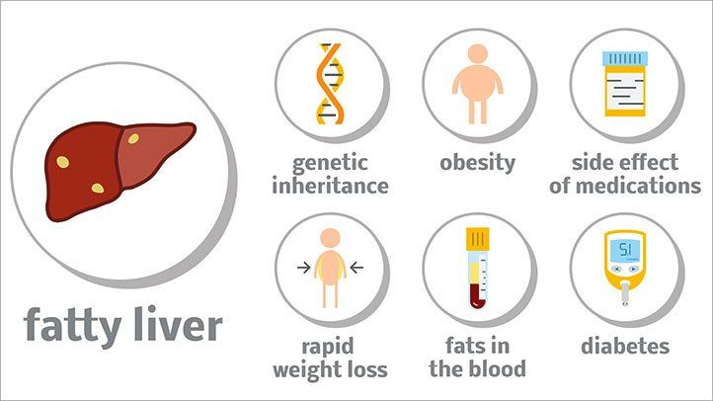
Disease Causes

Slide 6
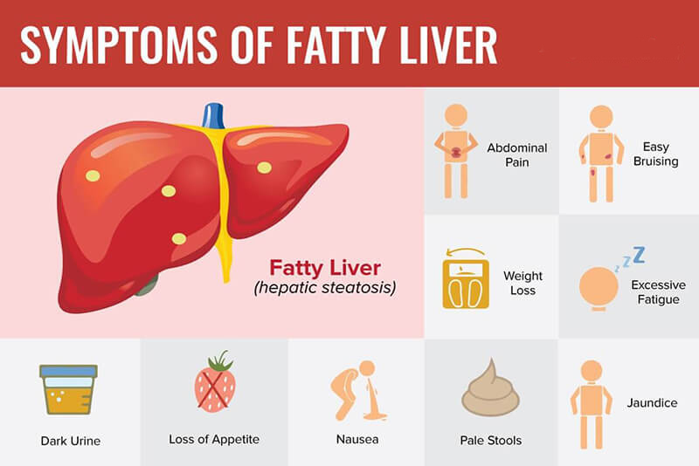

Slide 7
Motivation:
Fatty liver disease (FLD) is a common clinical complication; it is associated with high morbidity and mortality. Fatty liver disease can’t be identified at an early stage. It can be identified using ultrasound, CT scan and MRI at the final stage. However, an early prediction of FLD patients provides an opportunity to make an appropriate strategy for prevention, early diagnosis and treatment. In the existing system, KNN and Naïve Bayes are used to predict liver disease. Naïve Bayes(72.5 AUC value) gave better result than KNN(61.9 AUC value). We aimed to develop a machine learning model to predict FLD that could assist physicians in classifying high-risk patients and make a novel diagnosis, prevent and manage FLD. So the main motivation behind this project is to detect FLD in the early stages of the disease at a low cost.

Slide 8
Literature survey:
Author Name | Title of the Project | Description
Hartatik Mohammad Badri Tamam Arief Setyanto | Prediction for Diagnosing Liver Disease in Patients using KNN and Naïve Bayes Algorithms | Naïve Bayes and KNN are used. Naïve Bayes given better results than KNN
Cheng-fu Xu Zhe Shen Chao-hui Yu You-ming Li | Application of Machine Learning Techniques for Clinical Predictive Modeling: A Cross-Sectional Study on Nonalcoholic Fatty Liver Disease in China | Logistic Regression, KNN, SVM, Naïve Bayes and Bayesian Network are used. Bayesian Network given better results than others.
Chieh-Chen Wu Wen-Chun Yeh Wen-Ding Hsu Md Mohaimenul Islam | Prediction of fatty liver disease using machine learning algorithms | Random Forest, Naïve Bayes, ANN and LR are used. Random Forest given better results than others.

Slide 9
Existing System
Classification models such as Random Forest (RF), Naïve Bayes (NB), Artificial Neural Networks (ANN), Logistic Regression(LR) were developed to predict FLD. The area under the Receiver Operating Characteristic curve (ROC) was used to evaluate performances among the four models.
Disadvantages:
To detect FLD is a difficult task and it’s detecting at the last stages.
By using the number of filters we are detecting the FLD which increases the cost of the system and also expert person needs to be there to detect the FLD

Slide 10
Proposed System
ANN(Artificial Neural Network) and XG-BOOST.
XG-Boost is a decision-tree-based ensemble Machine Learning algorithm that uses a gradient boosting framework. In prediction problems involving unstructured data (images, text, etc.)
XG-Boost is a scalable and accurate implementation of gradient boosting machines and it has proven to push the limits of computing power for boosted trees algorithms as it was built and developed for the sole purpose of model performance and computational speed.
By using the system and software only we can detect the FLD.
No need for an expert to declare the result.
There is no use of machines, filters and expert people this obviously reduces the cost.
Accuracy is also increased
ADVANTAGES:

Slide 11
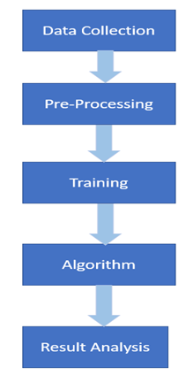
Architecture

Slide 12
Result Analysis:
 | Naïve Bayes | Random Forest | Hybrid (ANN+XGBoost)
Accuracy | 62.570455 | 82.424546 | 86.8836
Sensitivity | 62.676507 | 82.530598 | 86.9896
Specificity | 62.348799 | 82.202890 | 86.6619
AUROC | 0.788671 | 0.888671 | 0.9060

Slide 13
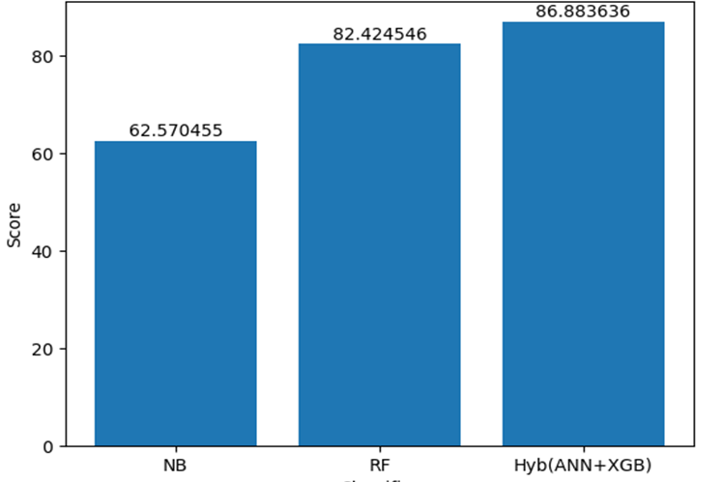
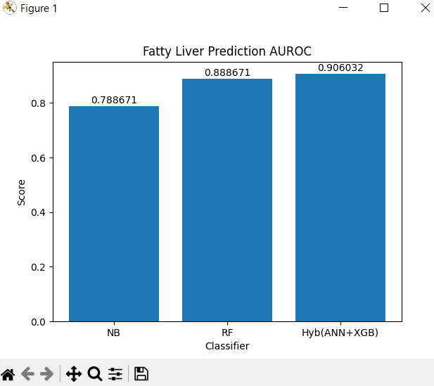
Graphical representation
Accuracy
AUROC

Slide 14
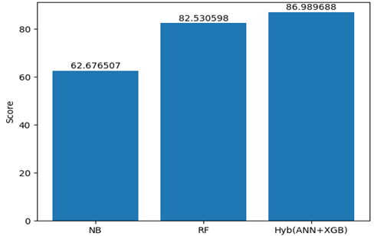
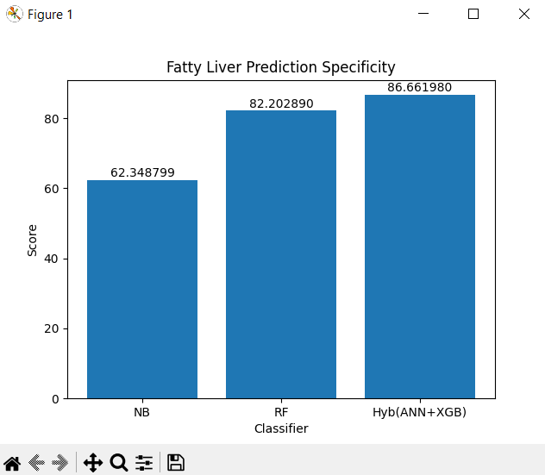
Specificity
Sensitivity

Slide 15
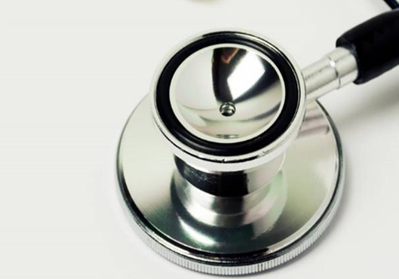
Conclusion:
The three machine learning methods used in this work are contrasted in order to accurately predict fatty liver disease. The hybrid of ANN with the XGBoost model, however demonstrated superior performance than conventional machine learning methods. Implementing a hybrid ANN-XGBoost approach in the clinical setting could assist doctors in classifying individuals with monitoring, early treatment, and care for fatty liver.

Slide 16
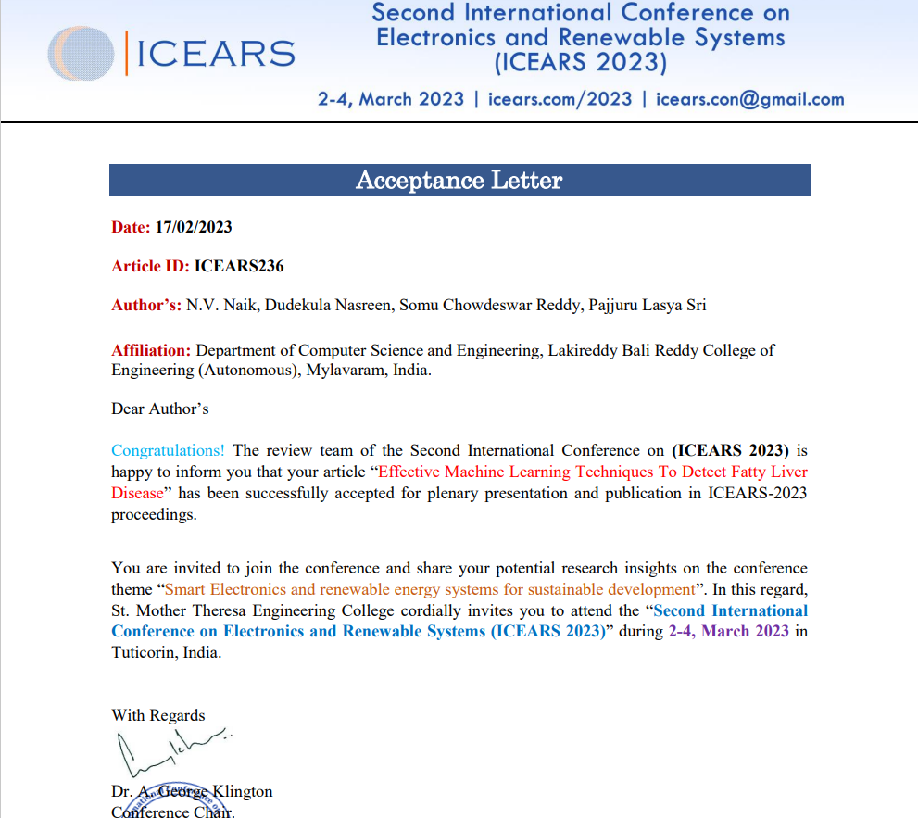

Slide 17
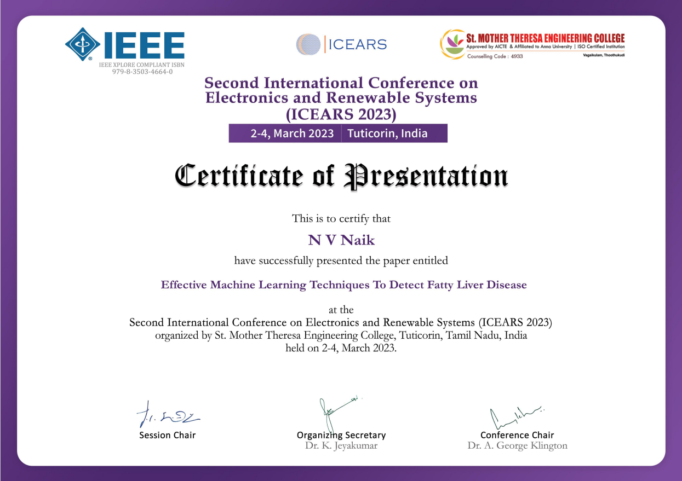

Slide 18


Slide 19
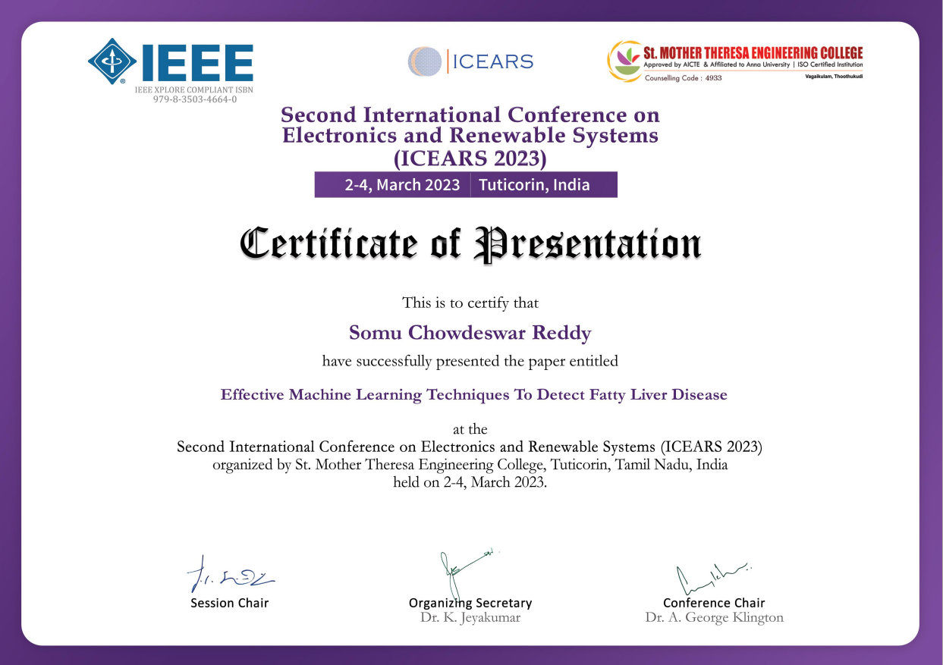

Slide 20


Slide 21

Thank you

